Slide 1

Authorship Attribution using ML
Zeinab Hussein Keserwan
Mohammed Adnan
Kartik Banga
Harish Nair

Slide 2
Data Used
Preprocessing partitions
Removed punctuations and stop words
Applied word tokenization
Lemmatization
Well known books from Harvard Classics
“The Alchemist” by Ben Jonson
“Apology” by Plato
“Don Quixote” by Miguel de Cervantes Saavedra
“David Copperfield” by Charles Dickens
“The Odyssey” by Homer
“Crime and Punishment” by Fyodor Dostoyevsky
Feature Engineering - Vectorization
BOW
TFIDF
NGRAMS
WORD2VEC - failed baseline model
DOC2VC- failed baseline model
Data Analysis
Length analysis
Sentiment analysis
Frequent words

Slide 3
Classification Models:
1. KNN
2. Naive Bias
3. Decision Trees
4. Random Forest
5. Multinomial Logistic regression
Champion model……
Naive bayes with bigram embedding

Slide 4
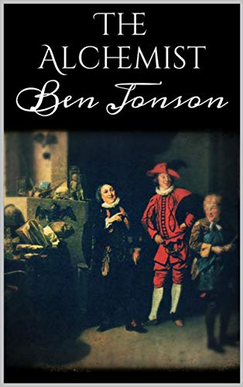
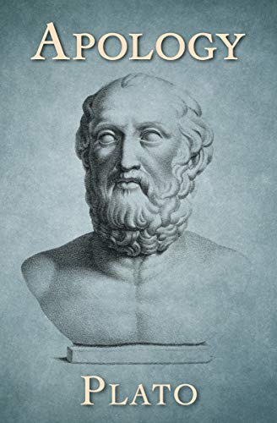
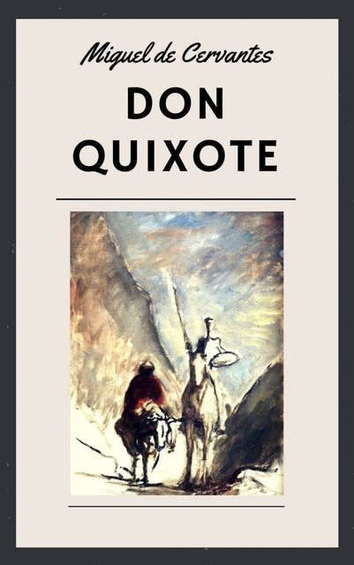
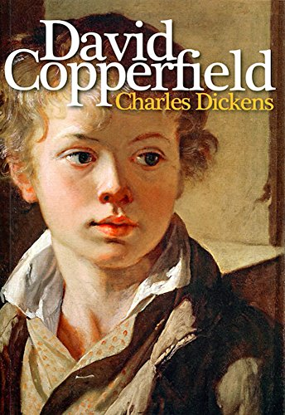
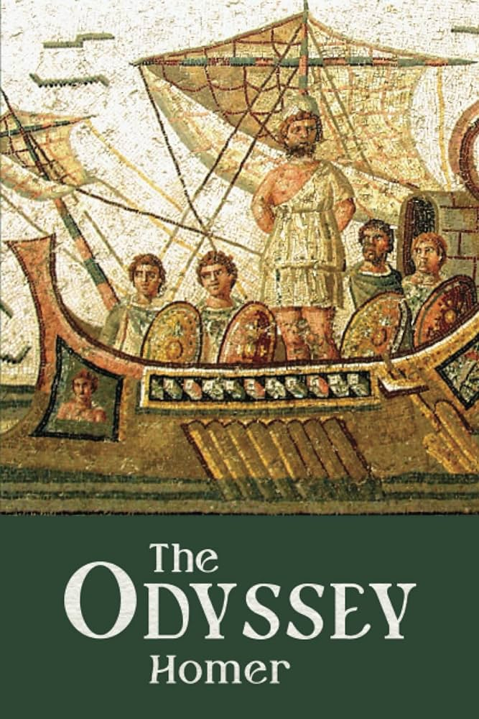
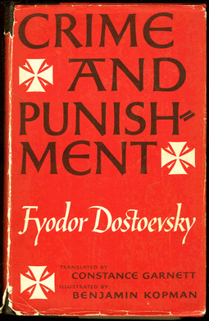
Books used

Slide 5
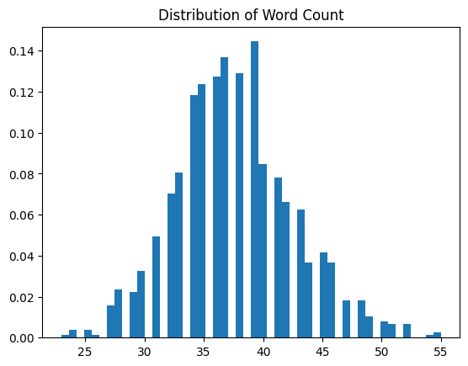
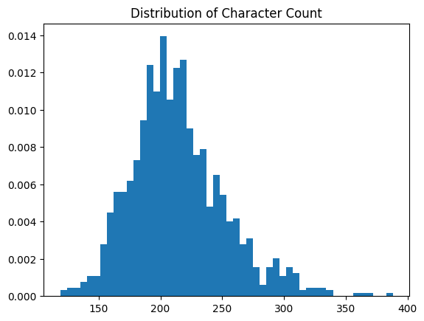
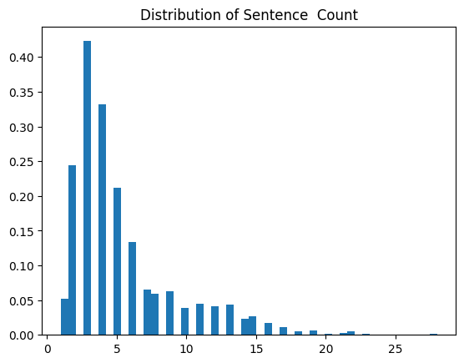
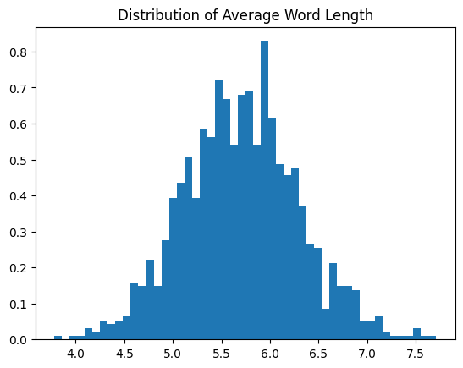
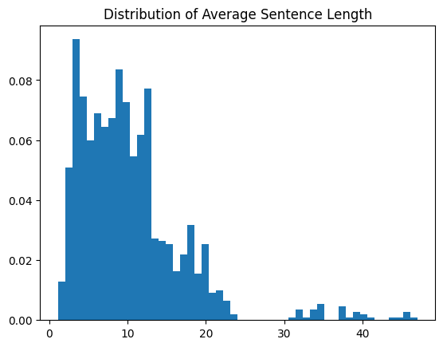
Data Analysis: Length Analysis

Slide 6
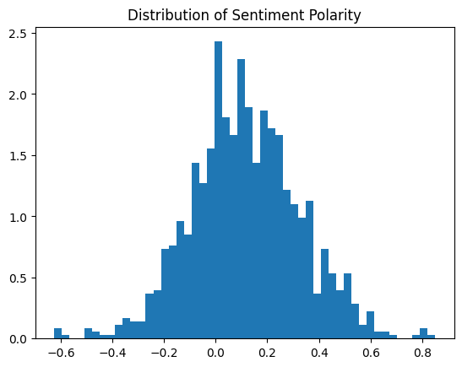
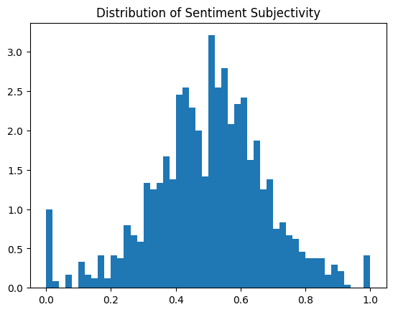
Data Analysis: Sentiment Analysis

Slide 7
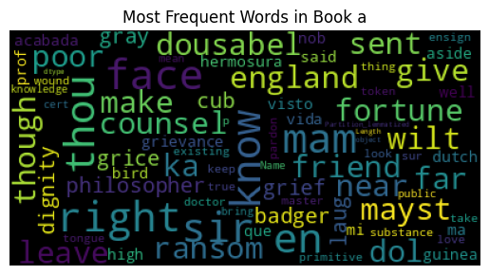
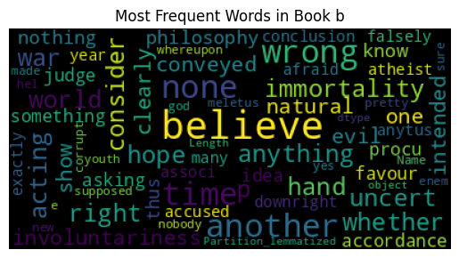
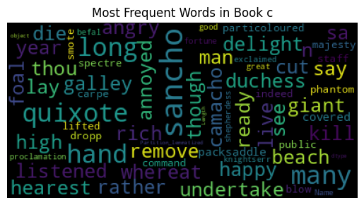
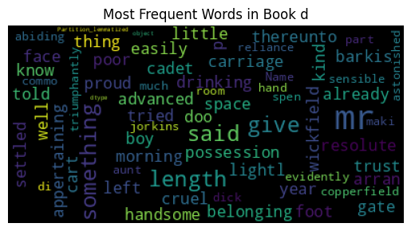
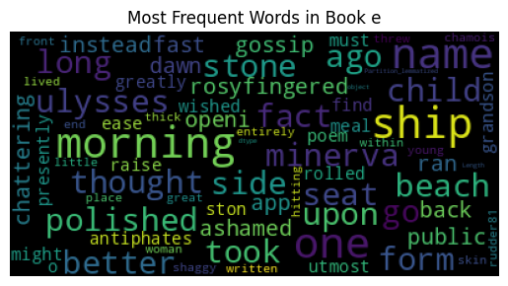
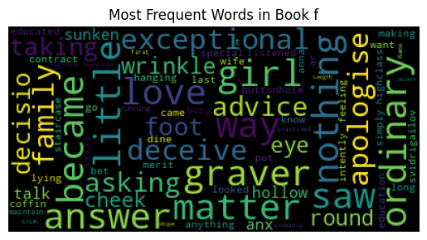
Data Analysis: Frequency Analysis

Slide 8
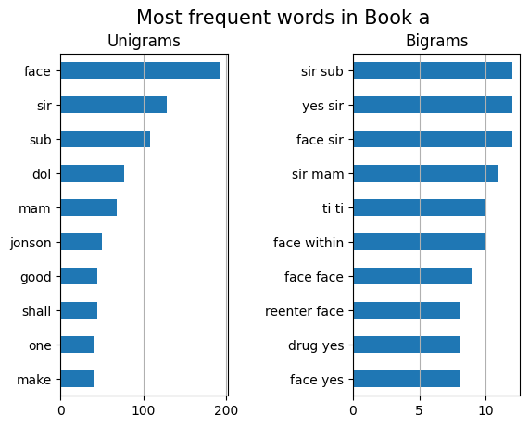
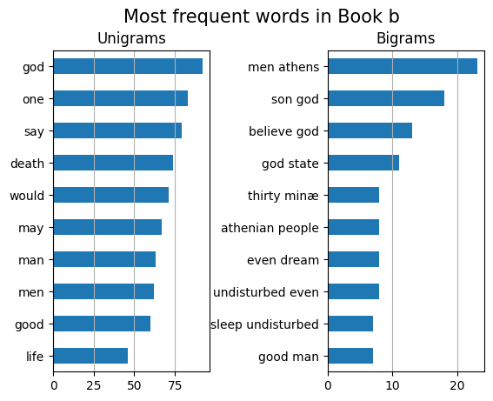
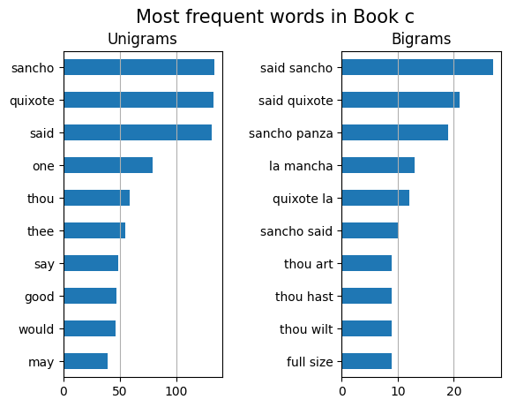
Data Analysis: Frequency Analysis

Slide 9
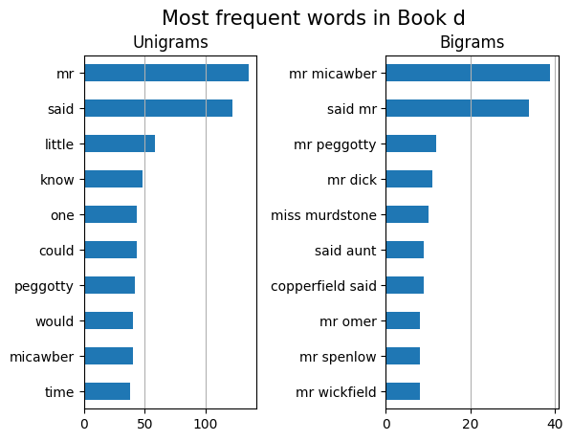
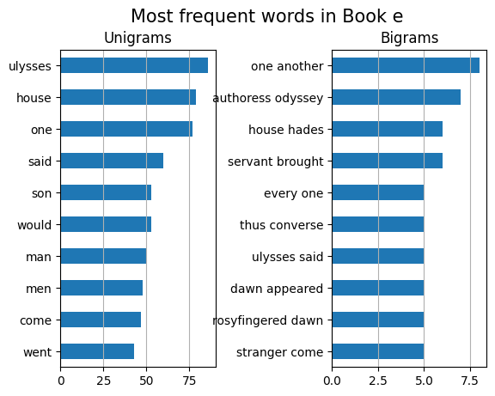
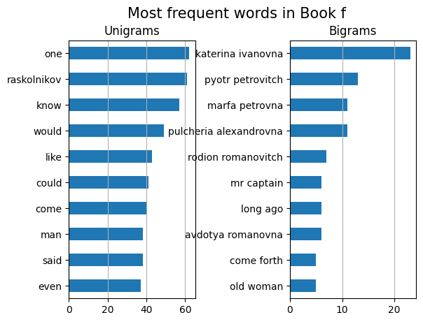
Data Analysis: Frequency Analysis

Slide 10
Feature Engineering: Vectorization
Bag-of-Words: It starts with the creation of a vocabulary of all unique words present in the corpus. Each document is then transformed into a vector, where elements of the vector represent the frequency of each word in the document.
N-grams: It starts with the creation of a vocabulary of all unique single words and two-word combinations present in the corpus. Each document is then transformed into a vector, where elements of the vector represent the frequency of each n-gram in the document.
TF-IDF: It creates a document-term matrix where each row corresponds to a document, and each column corresponds to a unique term in the entire corpus. The TF-IDF value for each term in a document is calculated as the product of its term frequency (TF), which is how often a term appears in a specific document, and its inverse document frequency (IDF), which penalizes terms that are too common across all documents.

Slide 11
Classification Models:
1. KNN
2. Naive Bias
3. Decision Trees
4. Random Forest
5. Multinomial Logistic regression

Slide 12
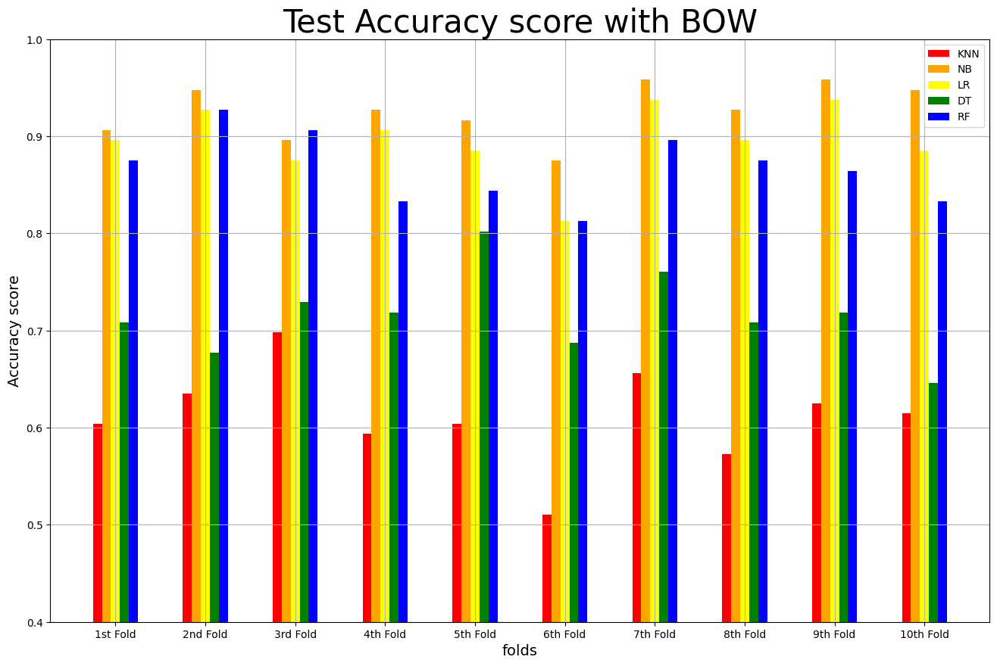
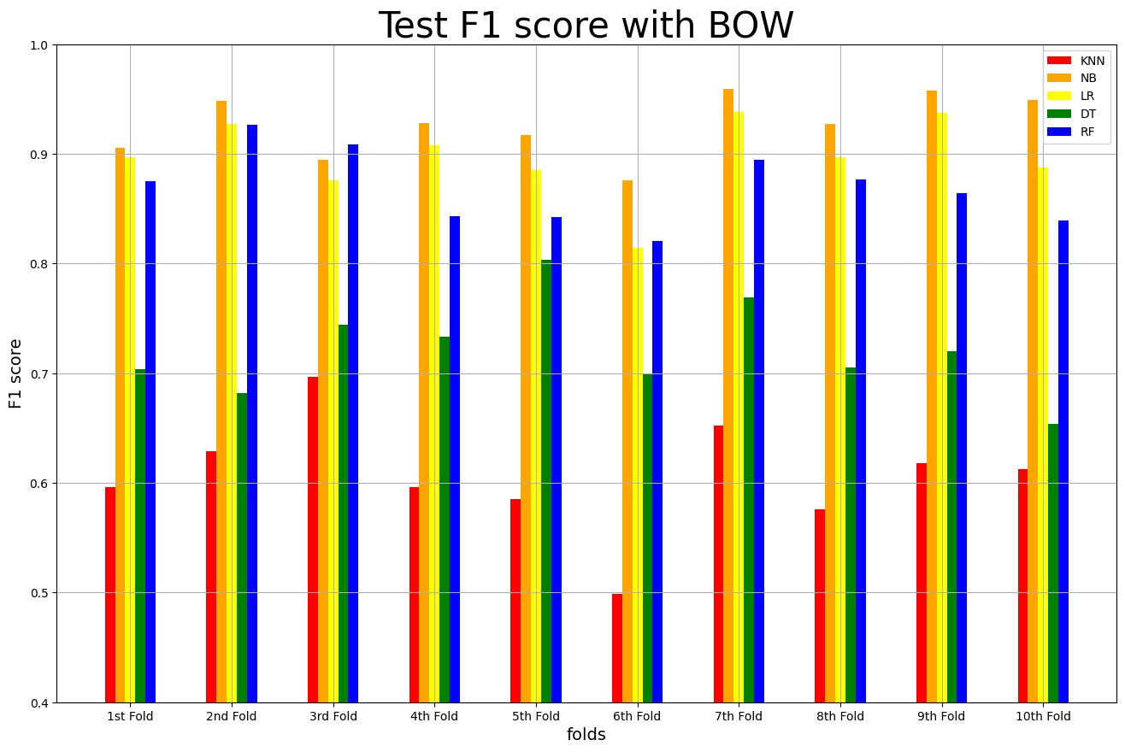
Analysis of models on BOW

Slide 13
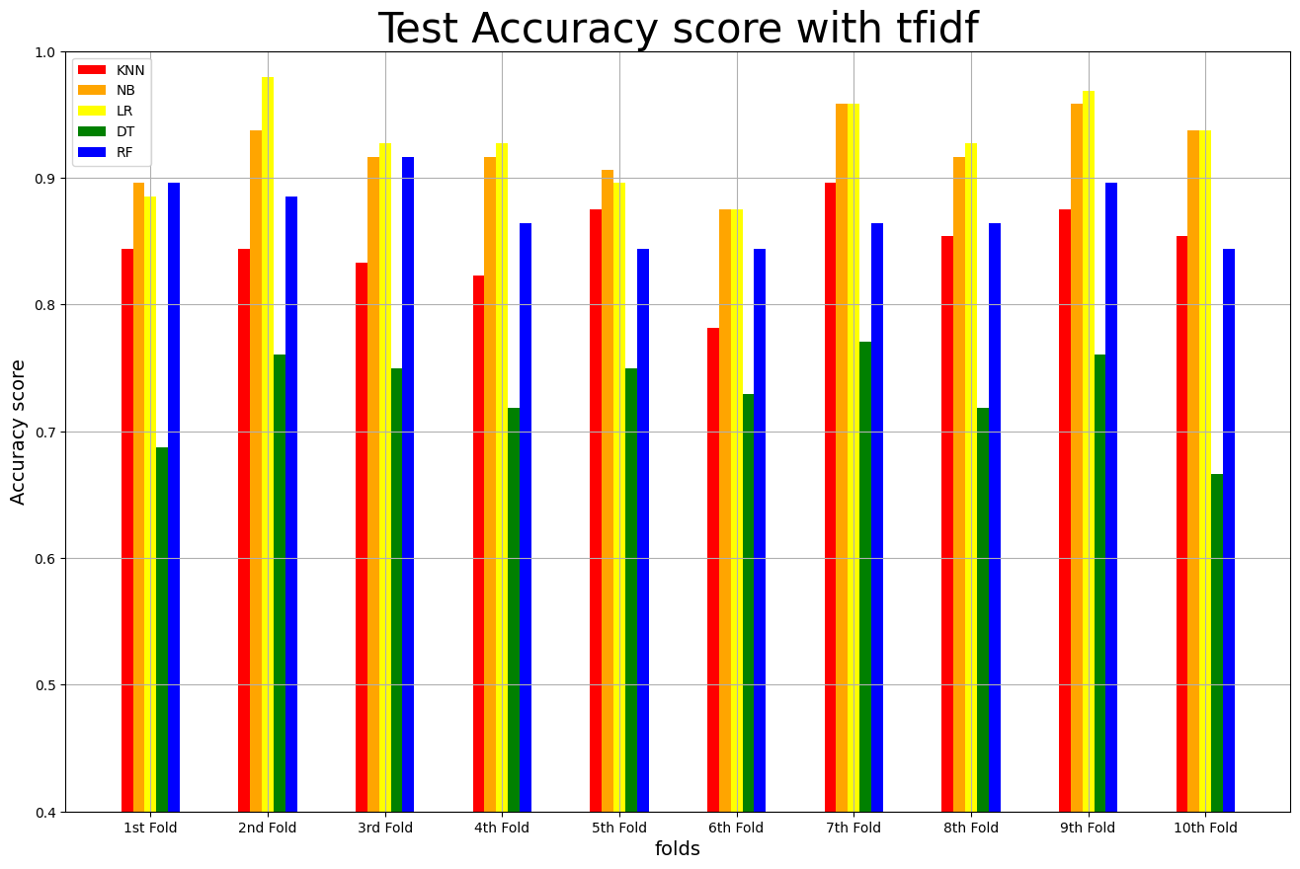

Analysis of models on TFIDF

Slide 14
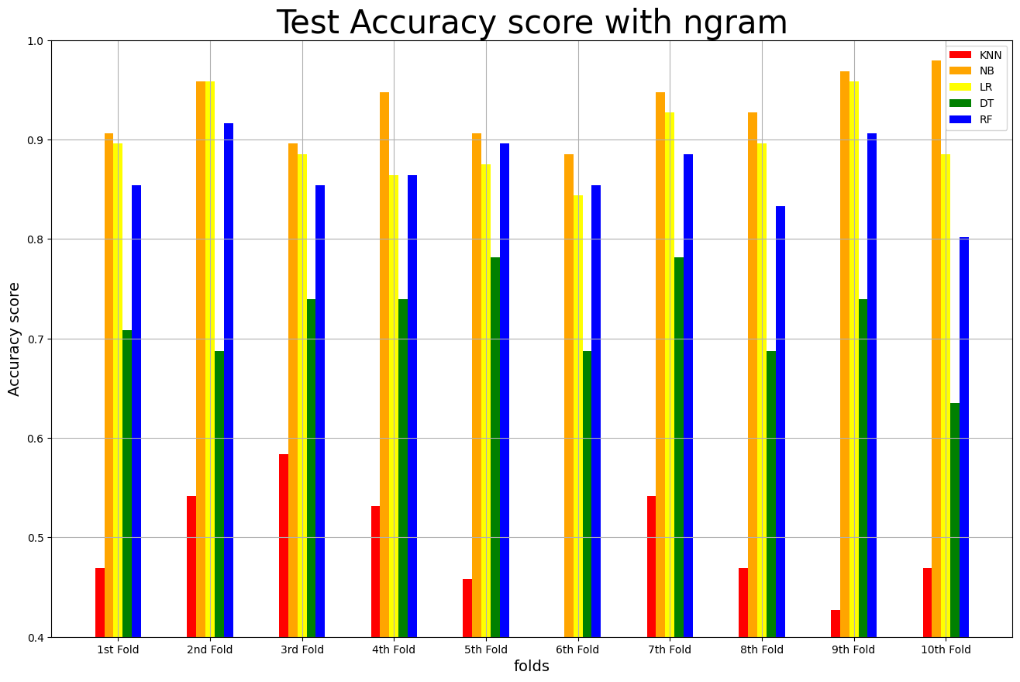
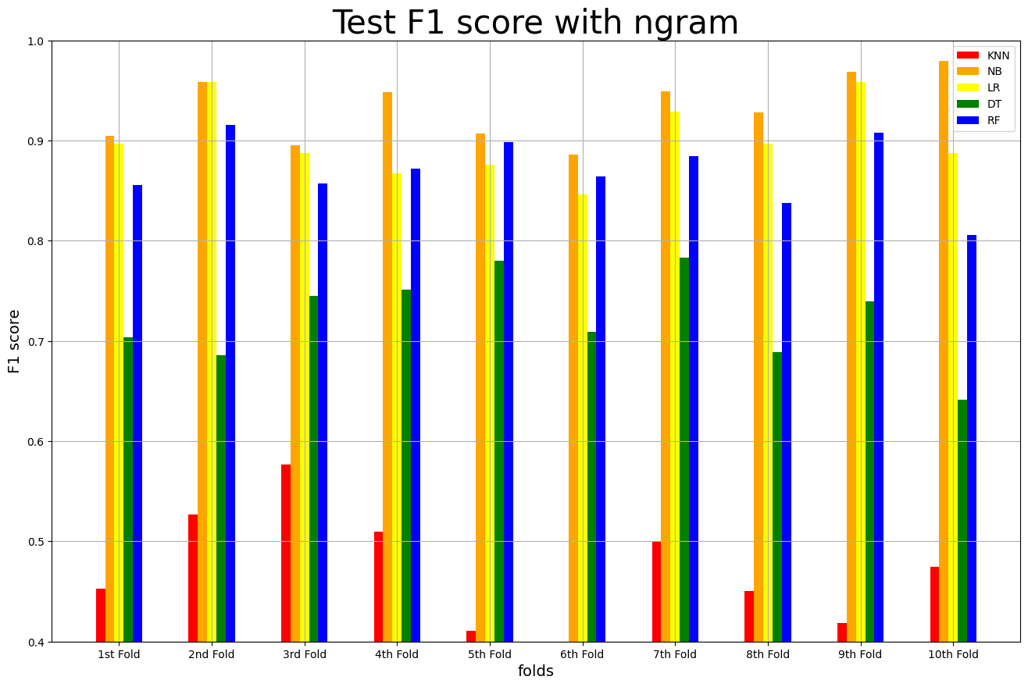
Analysis of models on NGRAM

Slide 15
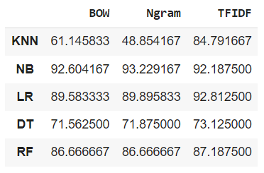
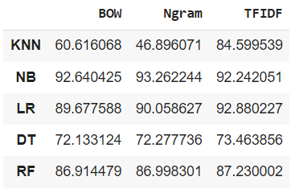
F1 score comparison
Accuracy
F1 - Score

Slide 16
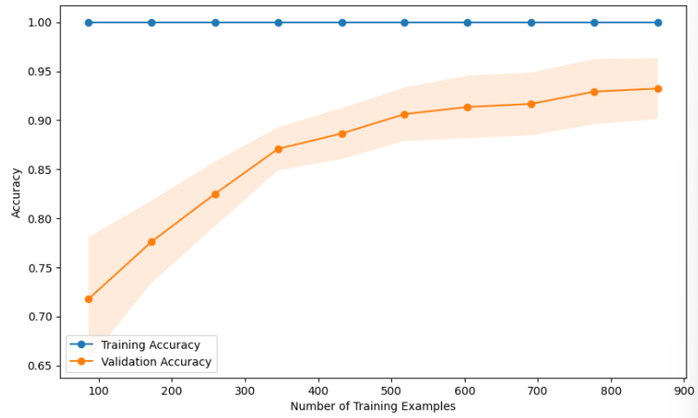
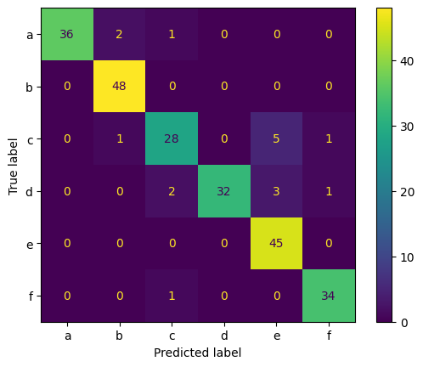
Champion model evaluation……
Multinomial Naive bayes with Ngram embedding on lemmatized data
Word Embedding techniques: BOW, TF-IDF, Uni-gram, Bi-gram

Slide 17
Thank you!

